Slide 1
An Education Session to Honor the 50th Anniversary of the Vietnam War
By the Nebraska Vietnam War Commemoration Committee
2013

Slide 2
Goal
To honor Vietnam Veterans and their families for their service.
To raise awareness of the issue and events which shaped the war and its outcome.

Slide 3
The Program
A one hour session geared for secondary school education students and the general public which would explain the war from the perspective of:
the history/politics
the legacy
those who served
In addition to the classroom program, a resource packet will be provided with the lesson plan which will facilitate further education.

Slide 4
Class Outline
Geographic and Historical Content
Where is Vietnam?
Some thoughts about its geography
Recent History
A French Colony
Japanese Occupation
Liberation Movement
Separation

Slide 5
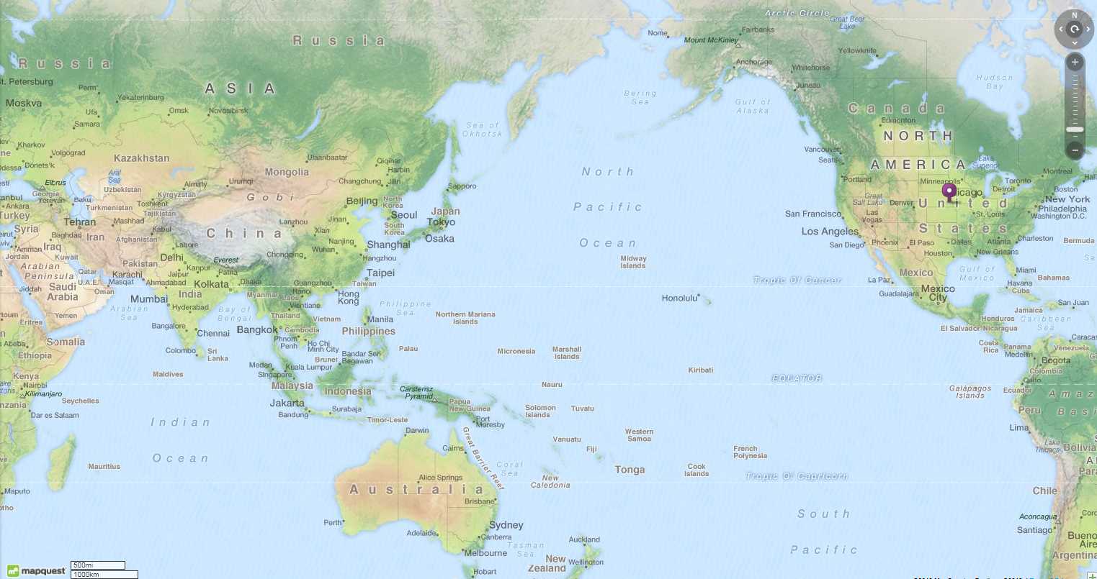
Lincoln, Nebraska to Hanoi, Vietnam 8,935 miles & 13 time zones

Slide 6
Distance from Hanoi to:
Hong Kong
543 miles
Manila
1090 miles
Bangkok
614 miles
Singapore
1364 miles
Given its location and geography, Vietnam’s social, economic and political development, more often than not, has been linked to that part of the world other than for periods of time when it was under the rule of China or France.

Slide 7
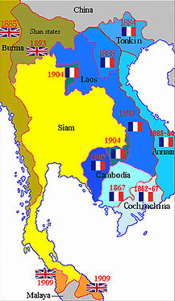
French Indochina
As early as the 1780’s France had an involvement in Vietnam, but it wasn’t unit the 1860’s that France colonialized the Mekong Delta. By the 1880’s French Indochina was created which lasted 70 years.
Discuss Colonialism

Slide 8
French Indochina
In 1940 Japan ruled Vietnam and installed a Vichy French government. During this time Ho Chi Minh worked with American intelligence to gather information about the Japanese.
After the war France tried to reassert its claim on the country, but in September, 1945 Vietnam was declared an independent country by Ho Chi Minh.
In 1946 the first Indochina war began between the France and the Vietnamese. This lasted until the French were defeated at Dien Bien Phu in 1954.
In 1954 the Geneva Convention divided the country between the North supported by the Soviets and the South supported by the United States.
1954-1974 second Indochina war.
1976 unification of Vietnam.

Slide 9
Class Outline
US Involvement – rational context
Key events which shaped the time 1955-1975

Slide 10
Class Outline
Although American troops were in Vietnam for 10 years, our overall involvement was much longer.
Who was the 1st president to grant aid to Vietnam?
In 1950 Truman granted $15 million in aid to help the French.

Slide 11
Class Outline
Why were we involved?
To contain the spread of communism.

Slide 12
Key Assumptions
Communism could be contained in Southeast Asia, as it had been in Korea and Europe following WWII.
If we didn’t stop communism in Vietnam it would spread throughout Asia. (domino theory)
Our allies would support us.
American people would
support ongoing
involvement.
The domino
theory
LAOS
THAILAND
BURMA
PHILLIPINES
CAMBODIA
MALAYA
KOREA
INDONESIA
VIETNAM

Slide 13
Vietnam & US Events
1955
Republic of Vietnam established
1956
President Diem cancels elections
1957
Communist Forces enter South Vietnam
Montgomery Bus Boycott (Rosa Parks)
Eisenhauer elected President
Sputnik Satellite launched

Slide 14
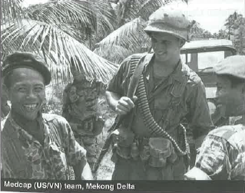
Vietnam & US Events
1958
US Military Advisor sent to Vietnam
Hula Hoop makes it debut

Slide 15
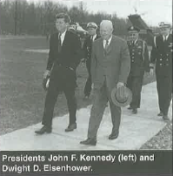
Vietnam & US Events
1959
North Vietnamese infiltration of Vietnam
1st American casualty
1961
Green Beret in Vietnam
1962
Alaska and Hawaii statehood
Castro becomes Premier of Cuba
Kennedy President
Berlin Wall
Cuban Missile Crisis

Slide 16
Vietnam & US Events
1963
Buddhist Monk burned himself
President Diem assassinated
Dr. King “I Have a Dream”
President Kennedy Assassinated

Slide 17
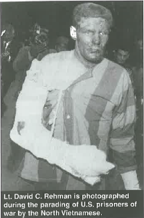
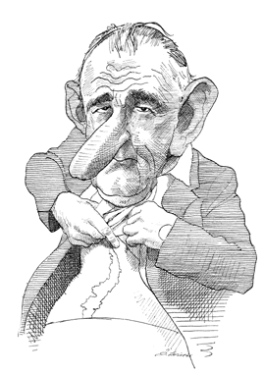
Vietnam & US Events
1964
First POW in North Vietnam
US Civil Rights Act
Johnson elected President

Slide 18
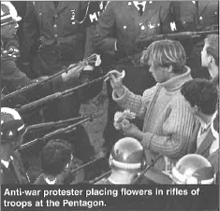
Vietnam & US Events
1965
First US Combat Forces
180,000 Troops in Country
250,000 Protest Against the War in Washington

Slide 19
Vietnam & US Events
1966
US Troop Strength 252,000
1967
US Troop Strength 500,000
US Casualties 15,000
1968
Tet Offensive
My Lai Massacre
US Casualties 30,000
Watts riots in LA
100,000 People protest the war in New York City
Dr. King Assassinated
Senator Kennedy Assassinated
President Nixon Elected

Slide 20
Vietnam & US Events
1969
US Troop Strength 543,482
US Casualties 40,000
1970
1972
North Vietnam major offensive
President Nixon announces Withdrawal
4 Students killed at Kent State
Israelis killed in Munich
Watergate
President Nixon Re-elected

Slide 21
Vietnam & US Events
1973
Peace Treaty signed
1974
1975
Fall of Saigon
1976
North and South Vietnam reunited
President Nixon Resigns

Slide 22
The Legacy – 50 Years Later
More Professionalism
US Military
Elimination of the draft
Active duty for disabled
Women in combat
Support for the whole person PTSD
A Different Perspective
More Support for Troops despite thoughts on the Conflict

Slide 23
The Legacy – 50 Years Later
Communism
No longer a major threat.
Vietnam
Assimilation of boat people/refugees
Major trading partner

Slide 24
The Legacy – 50 Years Later

Slide 25
Class Outline
Reflections
Picture of “Reflections” at the wall by Teter
Suggested “talking points” by those who served, Vietnamese
My Story by Secretary of Defense Hagel

Slide 26
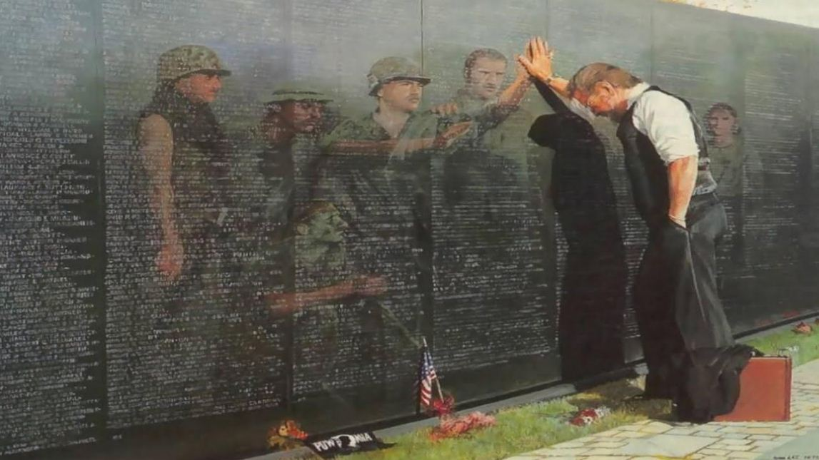
‘Reflections’ by Teter

Slide 27
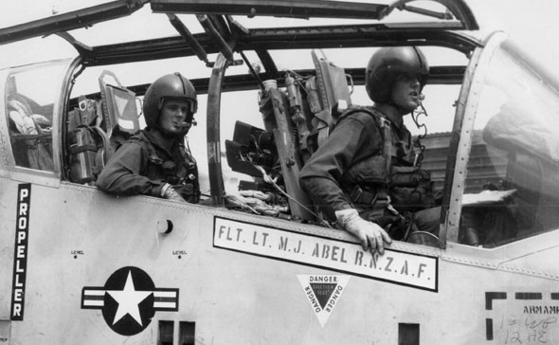
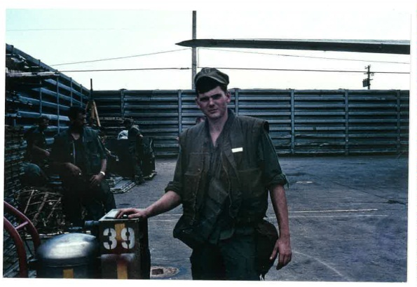
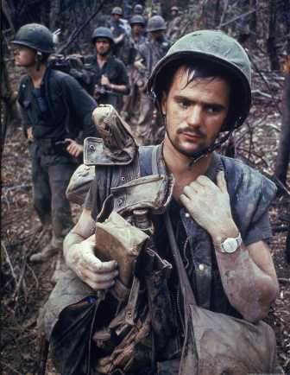
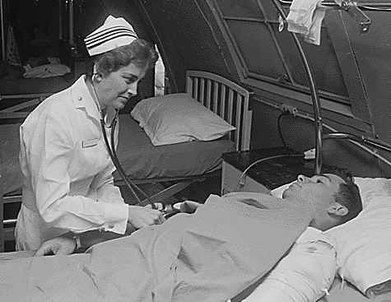
‘My Vietnam War Story’
Share personal story, photos, etc.
U. S. Marines
U. S. Air Force
U. S. Navy
U. S. Army

Slide 28
Talking Points
Did you enlist or were you drafted? If you enlisted what were the reasons? Any other military experience in your family?
Describe your Vietnam experience. What did you do? Where were you stationed?
What was your experience when you came home? What were you feeling when the war ended?
How did your Vietnam experience impact your life?
How has America changed with respect to war and the military experience since that time?

Slide 29
‘My War Story” by Secretary of Defense Chuck Hagel
My father was a World War II veteran in the Army Air Corps and spent more than two years overseas mainly in the South Pacific. My uncles were all WWII veterans. I grew up in a little town in Nebraska where Legion and VFW clubs were the centers of the town activities. It was our responsibility to serve our country. You didn’t question it. It was expected of each of us.
My brother Tom, now a professor at the University of Dayton and municipal court judge, and I both volunteered for the draft in 1967. He was one month behind me in basic training at Fort Bliss, advanced individual training at Fort Ord and Vietnam. We both had orders to go to Germany, but both volunteered to go to Vietnam. We were assigned to different units when we arrived in country. He ended up near the DMZ with the 11th Armored Calvary under Col. George S. Patton, and me with the 9th Infantry Division in the Mekong Delta. We put in for transfers to be with each other, knowing that it would probably never happen. A month later, he walked into my base camp in Bien Phouc (2nd Battalion of the 47th Infantry) and we were together, side by side, same squad, for the rest of our service in Vietnam. I left in December 1968 and Tom left in January 1969.
No one ever goes through the experiences of war and combat and not have it shape you in ways you don’t even realize. It impacts every fiber of your being. My attitude about committing a nation to war, asking our men and women to make sacrifices that no other Americans will ever be asked to make, is a deadly serious decision. War is not an abstraction. Before a nation goes to war, many tough questions need to be asked. It’s easy to get into war, but no so easy to get out of war. America has lived through this agonizing scenario for the last 11 years and we are still bogged down in the longest war we’ve ever fought.

Slide 30
‘My War Story” by Secretary of Defense Chuck Hagel
Most of our civilian and military leaders—Gen. Eric Shinseki, Lt. Gen. Greg Newbold and a few others being rare exceptions— forgot the critical leadership responsibilities of question, probe and challenge all assumptions about going to war beginning with intelligence. Colin Powell’s rules of engagement, the Powell Doctrine, that came from his two tours in Vietnam as a young infantry captain and major were disregarded, especially his last rule: what is your exit strategy?
Most Americans strongly support, admire and respect our military. In Gallup’s annual survey of the 15 leading institutions in America, the military is still the only institution held in high regard by the American people. No other institution is even close. But most Americans have very little understanding of the military. How could they? Most of society has been disconnected from military service since 1972, the beginning of the all volunteer military force, which I supported then and still support.
No matter the war, no matter the politics, a nation must always recognize the men and women who served their country and the tremendous sacrifices they and their families made. To have the Education Center at The Wall, which I authored the authorizing Congressional legislation for, include the veterans of the Iraq and Afghanistan wars is a unifying gesture, recognizing veterans from America’s three longest wars. It is appropriate and it is an American thing to do, paying tribute to those who embodied our country’s most important and lasting values; integrity, duty, honor, loyalty and courage.

Slide 31
Conclusion

